Slide 1
Let’s talk ARCore
by Ayusch Jain
Notes:
Hello Everyone,
My name is Ayusch, and I work at a company called UrbanClap as a Software Engineer. I’ve been working on Android for quite sometime and have recently started writing about android as well on Medium and my blog.
So, today we’ll be talking about AR or ARCore to be specific.
But let’s take a step back and think about why we need AR? The world was fine when I didn’t have AR and even now I’m fine when it does. I’ve never woken up to a day in my life saying: Yaar, kaash aaj life Mei augmented reality hoti, maza hi ajata.
Right? But it was no doubt exciting when I was able to put on a dog face and send it to my friend. When I was able to try out a fancy furniture in my home just using my camera. It’s a lot more convenient than actually placing the furniture there. And Pokemon GO, it was so much fun.
Now imagine having to create that game yourself, having to place a Pikachu right next to your bed. Now multiply that complexity a million times and imaging having to place hundreds of Pokemon around the globe. Seems like a mountainous task right.
What if I were to tell you that after this talk, you’ll be able to build a Pokemon Go for yourself? That would be a lie. Ofcourse I cannot teach you that, but what I can do is guide you through this gateway that is ARCore into the world of AR Development where you’ll be able to build exciting AR Apps really easily. And once you’ve gotten into it, sky’s the limit. Whatever you can imagine, you can create….
And also at the end of this talk, I’ll show you my own version of Pokemon Go!
So, having said that, let’s jump right into our topic.

Slide 2
Augmented Reality
A technology that superimposes a computer-generated image on a user's view of the real world, thus providing a composite view. ~Google

Slide 3
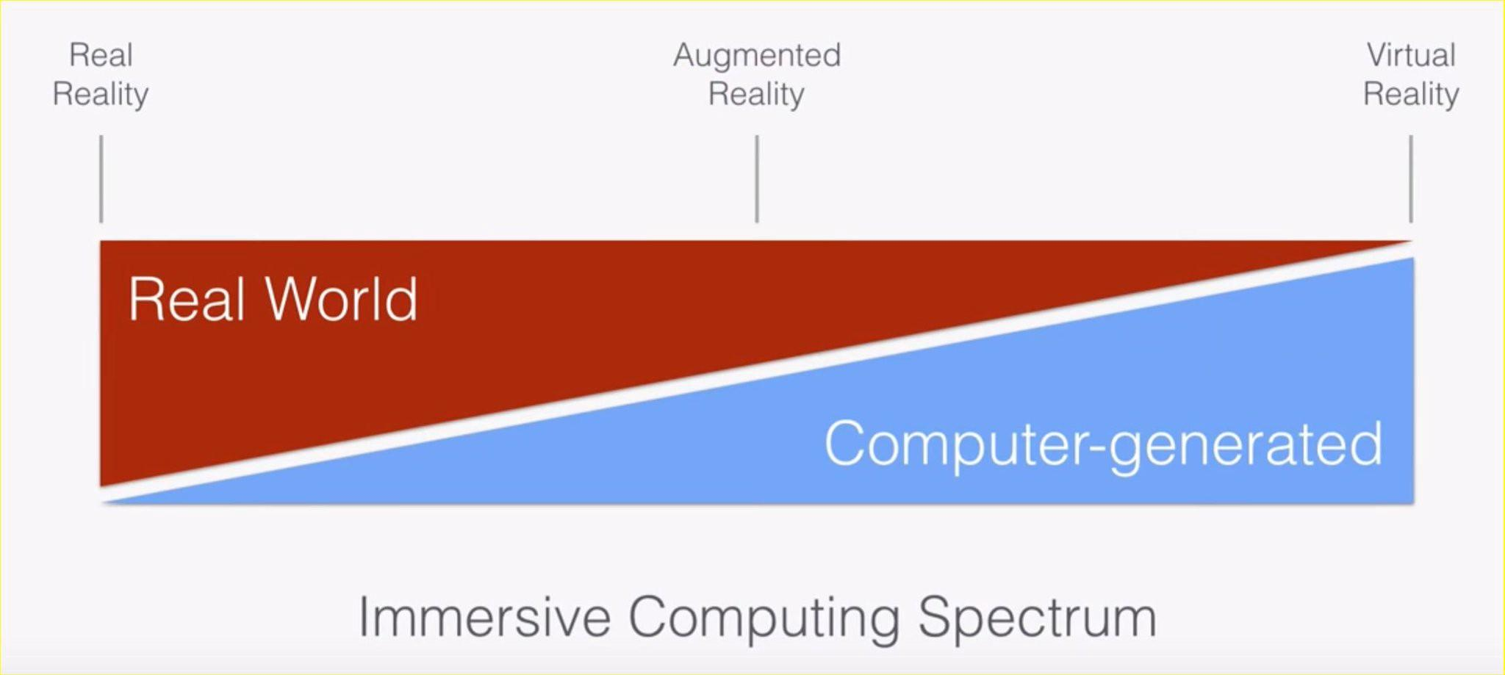

Slide 4
Uses of AR
Medical Training
Retail
Repair & Maintenance
Design & Modeling
Business Logistics
Tourism Industry
Classroom Education
Field Service

Slide 5
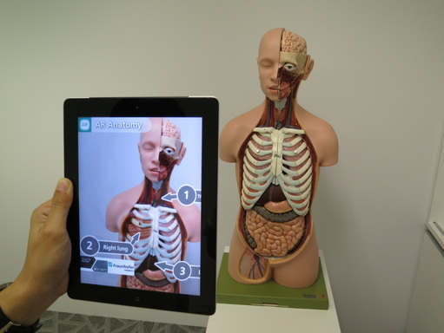
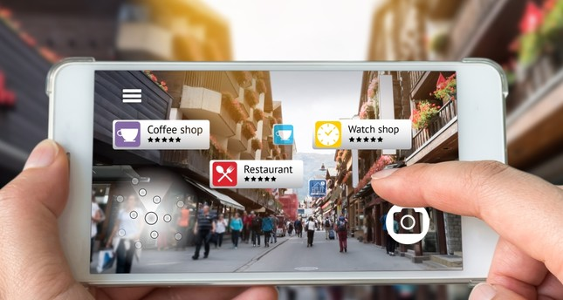
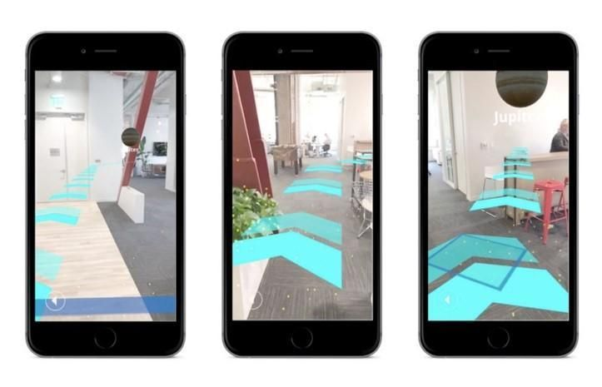

Slide 6




World without ARCore

Slide 7


Slide 8
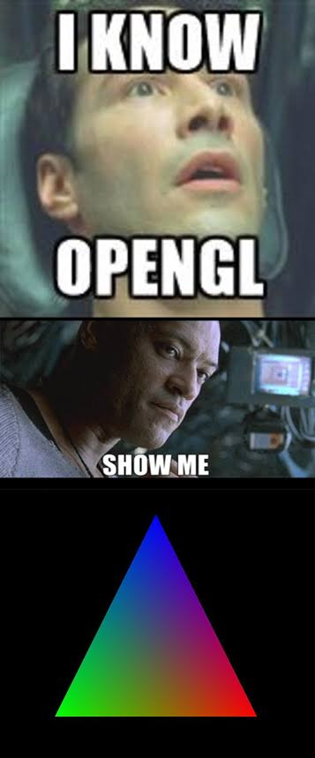

Slide 9
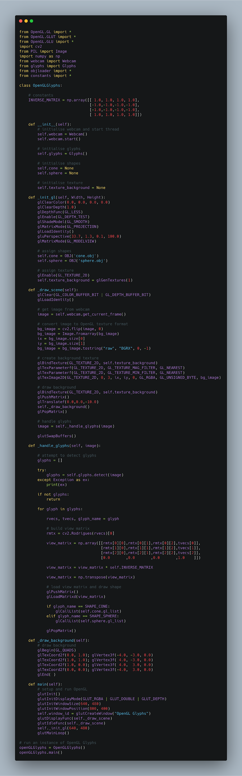

Slide 10
ARCore
ARCore is Google’s platform for building augmented reality experiences.
Android
iOS
Unity
Unreal

Slide 11
Three pillars of ARCore
Motion Tracking
Environmental Understanding
Light Estimation

Slide 12

Motion Tracking
Motion Tracking
Notes:
As your phone moves through the world, ARCore uses a process called concurrent odometry and mapping, or COM, to understand where the phone is relative to the world around it. ARCore detects visually distinct features in the captured camera image called feature points and uses these points to compute its change in location. The visual information is combined with inertial measurements from the device's IMU to estimate the pose (position and orientation) of the camera relative to the world over time.

Slide 13

Environmental Understanding
Environmental Understanding

Slide 14
Light Estimation
Light Estimation

Slide 15
But ARCore is a platform....

Slide 16
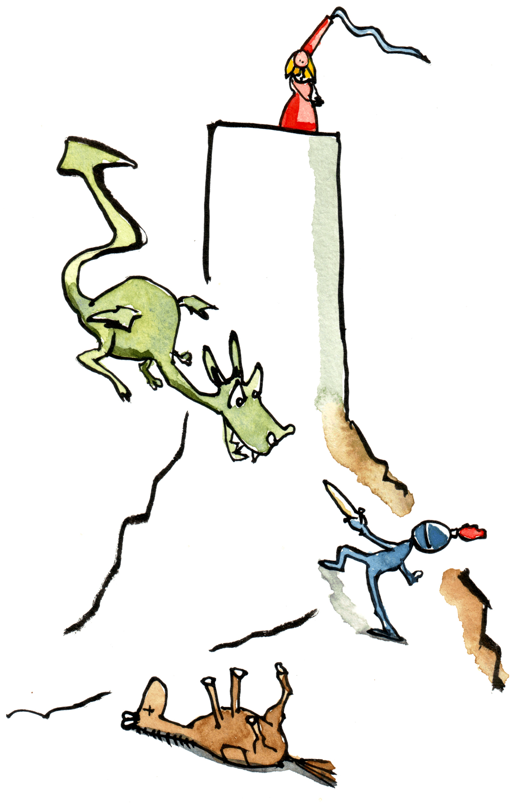
My first ARCore app
OpenGL
Me
My Dreams

Slide 17
We need an SDK...

Slide 18
Sceneform
It’s an SDK.
Sceneform makes it straightforward to render realistic 3D scenes in AR and non-AR apps, without having to learn OpenGL.
Elegant integration with Android Studio.
An Android Studio plugin for importing, viewing, and building 3D assets.

Slide 19
Let’s look at some code...

Slide 20
Some concepts...
Hit: ARCore uses hit testing to take an (x,y) coordinate corresponding to the phone's screen and projects a ray into the camera's view of the world.
Oriented points lets you place virtual objects on angled surfaces.
Anchor: When you want to place a virtual object, you need to define an anchor to ensure that ARCore tracks the object's position over time.

Slide 21
What’s Next?

Slide 22


Slide 23
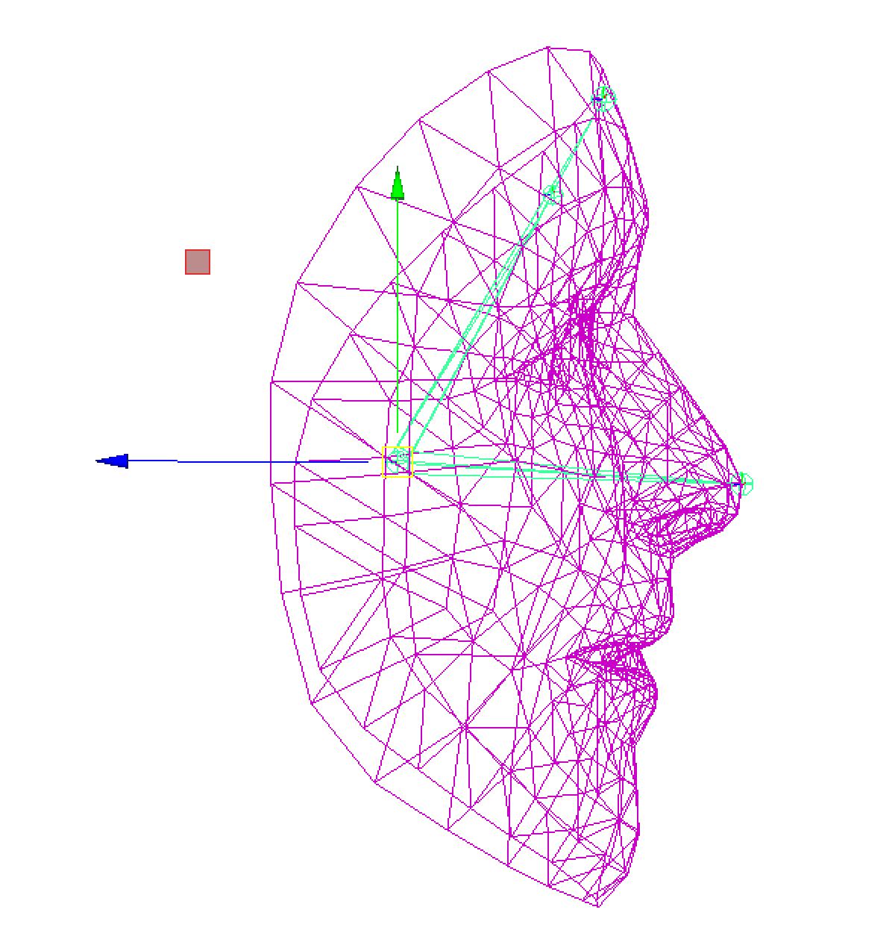
Augmented Faces

Slide 24
Cloud Anchors

Slide 25
Resources
https://developers.google.com/ar
For getting started:
https://ayusch.com/what-is-arcore/
https://ayusch.com/building-arcore-app-android-studio/
https://ayusch.com/arcore-building-augmented-images-application/
https://ayusch.com/augmented-reality-android-cloud-anchors/

Slide 26
Thank You!

